Slide 1
Agenda
Possibility of unconventional integrated smoke detector Advantages: The robustness, Possibility to apply for open cavity system
Comparison of particle characterization techniques
8.8.2016, Nobuyoshi Hiramatsu

Slide 2
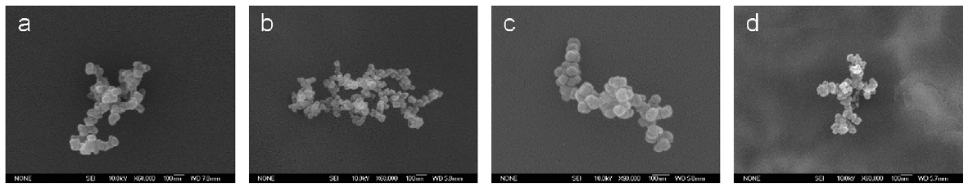
Smoke Particles
Shape of smoke particle
A Spherical particle
Far from spherical shape; the Lorenz-Mie scattering theory is not applicable
Scattered light:
Not depolarized
SEM image (Qiyuan Xie, et.al., Jour. Quant. Spect. Rad. Trans., 2007 )
Indication of smoke particles
The detection of depolarized scattered light indicates the existence of non-spherical particles.
( The depolarized light cannot be scattered from the spherical particles taking the central symmetry of the particle into consideration. )
A non-spherical particle
Scattered light:
Depolarized

Slide 3
Integrated Smoke Detector
Conventional smoke detector (Detecting scattered light)
Proposed smoke detector (Detecting depolarized scattered light)
Advantages:
Sensitivity
- Avoid cross-sensing problem against water droplet.
- Decrease stray light intensity
- Able to collect scattered light from a broad angle to increase the signal intensity.
- Applicable to detect diverse sized and random shaped particles
Integration & Cost
- More integration is possible since spatial placement accuracy is not required
- Possibility to utilize LED as a light source
Smoke particle
Polarizer
Photo-detector
Laser(or LED)
Polarizer

Slide 4
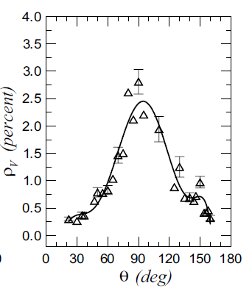
Integrated Smoke Detector
Prior Studies
Prior Arts
Maximum depolarization rate indicated at the 90 degrees for smoke or soot particles, in several studies including both experiments and simulations.
1. Photoelectric smoke-sensitive fire detecting device based on depolarization rate (2007)
- Calculate the depolarization rate to detect the existence of the smoke particle
2. Light scattering smoke sensor (1997)
3. Electronic device having a proximity detector(2006)
- Combine a smoke detector with a proximity sensor
Depolarization rate ρv=IHV/IVV(%)
Stefano di Stasio, Jour. Quant. Spect. Rad. Trans(2002) .
Discussion
Advantage:
- Robust and Simple optical system, No calibration
- More integration, LED available
- Possibility to apply to an open-cavity system, or to be combined with other optical sensor such as a proximity sensor.
Disadvantage:
- The signal light suppose to be weak. However SN-ratio does not apply to, since the stray light and the cross-sensing problem against water droplet are avoidable.

Slide 5
Particle characterization techniques (for Aerosol)
Overview
Dynamic Light Scattering
Brownian motion of the particles dynamically fluctuates scattered light intensity. The particle diameter is directly associated with the diffusion constant calculated in the autocorrelation function of the intensity with the Stokes-Einstein equation.
Laser Diffraction
The speckle pattern of a well designed optical system is associated with the spatial fourier transformation of the 2-D projection of particle distribution, according to the Fraunhofer diffraction theory, .
Phase Doppler Anemometry
As a particle passes through propagating light, the frequency of the scattered light will proportionally shifts with the velocity parallel to the light propagation due to the Doppler effect. By collecting the scattered light coming from the particle that pass through in the intersection of two focused laser beams, the light intensity beats as the individual scattered lights originate from both beams interfere.

Slide 6
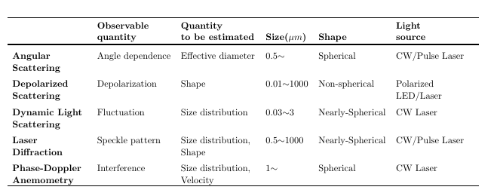
Particle characterization techniques (for Aerosol)
Comparison
Conclusion
For the particle characterization in an integrated sensor, the Laser Diffraction is the most suitable.
- No need of highly continuous laser
- No pre-required information in the shape and the optical property of sample particle
- Low concentration
For the smoke detection, the Depolarized Scattering is convenient.

